Slide 1

ECE 2700
Digital Circuits
Controller (Cont’d)
Non-Ideal Behavior
Copyright © 2010 Frank Vahid
Instructors of courses requiring Vahid's Digital Design textbook (published by John Wiley and Sons) have permission to modify and use these slides for customary course-related activities, subject to keeping this copyright notice in place and unmodified. These slides may be posted as unanimated pdf versions on publicly-accessible course websites.. PowerPoint source (or pdf with animations) may not be posted to publicly-accessible websites, but may be posted for students on internal protected sites or distributed directly to students by other electronic means. Instructors may make printouts of the slides available to students for a reasonable photocopying charge, without incurring royalties. Any other use requires explicit permission. Instructors may obtain PowerPoint source or obtain special use permissions from Wiley – see http://www.ddvahid.com for information.

Slide 2
Today’s Objectives
To learn an alternative way to create an FSM in Verilog
To understand the non-ideal behaviors of latches and flip-flops and how to fix them

Slide 3
One Way to Describe An FSM
`timescale 1 ns/1 ns
module Even1(Clk, A, B, Rst);
input A;
output reg B;
input Clk, Rst;
parameter X = 0, Y = 1;
reg State, StateNext;
// CombLogic
always @(State, A) begin
case (State)
X: begin
B <= 1;
if (A == 0)
StateNext <= X;
else
StateNext <= Y;
end
…
…
Y: begin
B <= 0;
if (A == 0)
StateNext <= Y;
else
StateNext <= X;
end
endcase
end
// StateReg
always @(posedge Clk)
begin
if (Rst == 1 )
State <= X;
else
State <= StateNext;
end
endmodule
A=0
B=1
X
A=1
A=1
B=0
Y
A=0
FSM
inputs
A
B
FSM
outputs
Combinational
logic
State
Clk
State register
StateNext

Slide 4
Here’s Another Way
`timescale 1 ns/1 ns
module Even1(Clk, A, B, Rst);
input A;
output reg B;
input Clk, Rst;
reg S, N;
parameter X = 0;
// StateReg
always @(posedge Clk)
begin
if (Rst == 1 )
S <= X;
else
S <= N;
end
A=0
B=1
X = 0
A=1
A=1
B=0
1
// CombLogic
always @(S, A)
begin
B <= ~S;
N <= S ^ A;
end
endmodule
A=0
Let
S be current state
N be next state
B = S’
N = S XOR A
If you need 2 bits for S and N, use:
parameter Sinit = 2'b00;

Slide 5
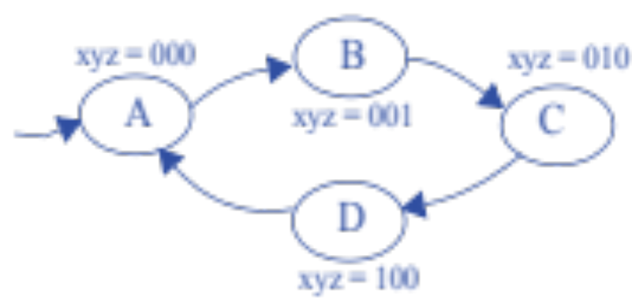
Let’s Practice
//Code for previous example
module Even1(Clk, A, B, Rst);
input A;
output reg B;
input Clk, Rst;
reg S, N;
parameter X = 0;
// StateReg
always @(posedge Clk)
begin
if (Rst == 1 )
S <= X;
else
S <= N;
end
// CombLogic
always @(S, A)
begin
B <= ~S;
N <= S ^ A;
end
endmodule
01
00
10
11
x = S1 S0
y = S1 S0’
z = S1’ S0
N1 = S1 + S0
N0 = S0’
If you need 2 bits for S and N, use:
parameter Sinit = 2'b00;

Slide 6
Solution
module MySys(Clk, Rst, x, y, z);
input Clk, Rst;
output reg x, y, z;
reg [1:0] S, N;
parameter Sinit = 2’b00;
always @(posedge Clk)
begin
if (Rst == 1 )
S <= Sinit;
else
S <= N;
end
always @(S)
begin
x <= S[1] & S[0];
y <= S[1] & ~S[0];
z <= ~S[1] & S[0];
N[1] <= S[1] ^ S[0];
N[0] <= ~S[0];
end
endmodule
01
00
10
11
x = S1 S0
y = S1 S0’
z = S1’ S0
N1 = S1 + S0
N0 = S0’

Slide 7
Variable Updates
What’s the difference between the following?
  X <= 0; //Non-blocking statement
  X = 0; //Blocking statement
Non-block statement
  Does not change the value for X immediately
    Instead, schedules a change of X
    Change takes effect at the end of the simulation cycle
  This means order doesn’t matter!
Simulation cycle i
x <= 0;
y <= 1;
…
Simulation cycle i+1
x <= 1;
z <= x + y;
At the end of simulation cycle i + 1,
x = 1 and z = 1

Slide 8
Question (AP)
//assume A and B are currently 0
Proc1:
A <= ~B;
Proc2:
B <= A;
What are the values for
A and B at the end of
the simulation cycle?
  A = 0, B = 0
  A = 0, B = 1
  A = 1, B = 0
  A = 1, B = 1
  ☹

Slide 9
Question (AP)
What is the final value for x?
  0
  1
  2
  3
  None of the above
//Assume x is originally 0
Proc4:
x = 1;
x <= x + 1;

Slide 10
More on Controller Implementation
All our FSMs had initial state
But our sequential circuits do not
How can we make sure a circuit start at the right state?
Inputs: x; Outputs: b
x=0
Off
b
’
b
x=1
x=1
x=1
On1
On2
On3

Slide 11
Flip-Flop Set/Reset
Assume the initial state is encoded as 10, we have
Designer must ensure reset controller input is 1 during power up of circuit
b
x
Combinational
logic
n1
n0
s1
s0
State register
clk
D
Q
’
D
Q
’
S
Q
R
Q
reset
controller

Slide 12
Non-Ideal Behavior of Latches & Flip-Flops
Can’t change flip-flop input too close to clock edge
  Setup time
    Time data input must be stable before clock changes from 0 to 1
    Setup time violation: stable value not present at internal latch
    For flip-flops, must allow time for master to latch on to data
  Hold time
    Time data must be held stable after clock changes from 0 to 1
    Hold time violation: new value doesn’t have time to loop around and stabilize in internal latch
clk
clk
D
D
setup time
hold time

Slide 13
Example of Setup Time Violation
This is a glitch due to an input
Why is this a hard problem to solve in the real world?
Setup time violation
D latch
C
D
S
D
1
Q
′
S
C
2
u
Q
R
3
4
u
R
Q
′
7
Leads to oscillation!
Q
5
6

Slide 14
Glitches Due to Inputs
Glitches due to inputs leads to metastability
  When a flip-flop’s state is not 1 nor 0
    Eventually the value will settle to either 1 or 0,
    but we don’t know which
  For internal circuits, we can make sure to
  observe setup and hold time
  But what if input is from external
  (asynchronous) source, e.g., button press?
clk
D
setup time
violation
Q
metasta
b
le
state

Slide 15
Technique to Avoid Metastability
Insert synchronizer flip-flop for asynchronous input
  Special flip-flop with very small setup/hold time
Caution: Synchronizer flip-flop doesn’t completely prevent metastability
  It only reduces the probability of metastability from occuring
ai
ai
synchroni
z
er

Slide 16
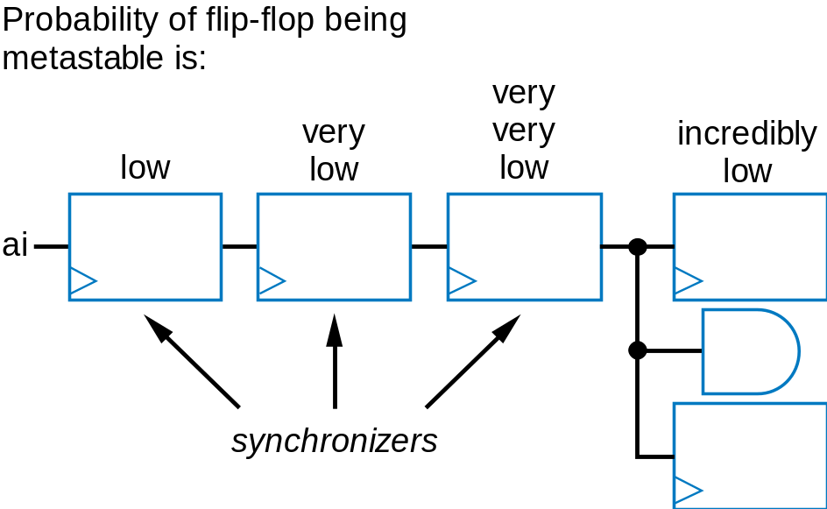
A Better Technique to Avoid Metastability
Add more synchronizer flip-flops to further reduce probability of metastability
  First flip-flop likely stable before next clock
  Second flip-flop very unlikely to have setup time violated
Drawback: change on input
is delayed to internal flip-flops
  By three clock cycles in circuit above

Slide 17
Output Glitches
Temporary values that are incorrect or unintended
  Appear soon after input changes, before stable new output values
Solution to output glitches is similar to the one for glitches due to asynchronous inputs
  Add a flip-flop to each output
  This is called registered output
b
x
xr
Combinational
D
n1
flip-flop
logic
n0
s1
s0
State register

Slide 18
Output Glitches (2)
Using registered output, the circuit has 1 cycle delay
To avoid this delay
  Add extra state register bit for each output
  Connect output directly to its bit
  No logic between state register flip-flop and output, hence no glitches
Drawback: more flip-flops, more logic
b
x
Inputs:
b
Outputs:
x
Combinational
x=
0
n1
logic
n0
00
0
b
′
nx
Off
s1
s0
sx
b
x=
1
x=
1
x=
1
State register
01
1
On1
10
1
On2
11
1
On3

Slide 19
Today’s Objectives
To learn an alternative way to create an FSM in Verilog
To understand the non-ideal behaviors of latches and flip-flops and how to fix them

Slide 20
Question
For the FSM to the right,
what is a corresponding Boolean
equation for output?
  Let S denote the current state
  Let X and Y be encoded as 0 and 1,
  respectively
input=0
output=1
X
input=1
input=1
output=0
Y
input=0

